Slide 1
Clustering MIT Docker
Presented by:
Kumar Ashutosh Anand
Matrik. Nummer: 00097180

Slide 2
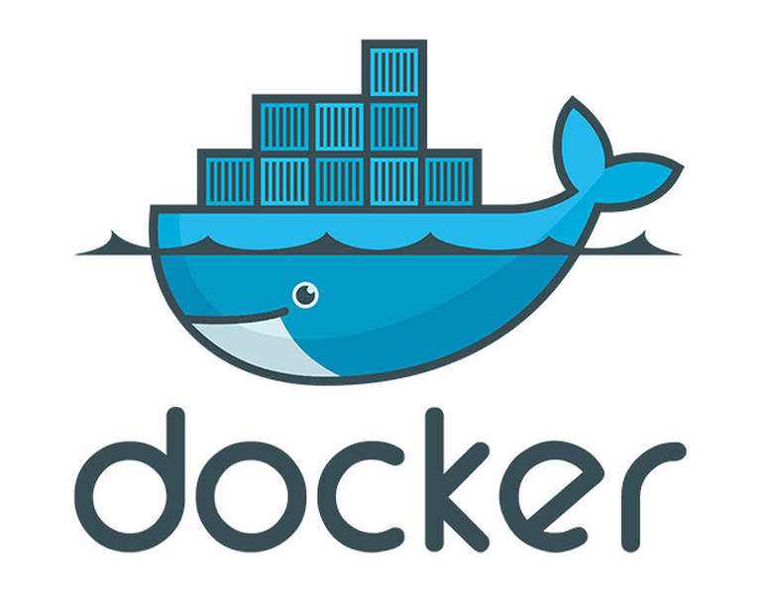
Clustering MIT Docker
OUTLINE
Docker Containers
Building Blocks
Techniques behind Docker
Docker Compose
Docker Swarm

Slide 3
Docker Container
What are containers?
What is Docker?

Slide 4
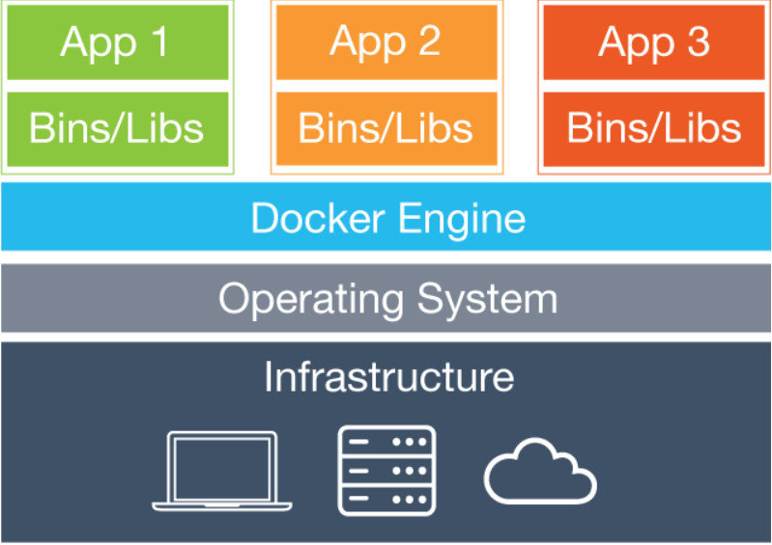
Docker Container
Containers: Containers is a light-weight virtualization which is also known as Operating system level virtualization. Containers can run in multiple isolated user space instances on the top of the operating system’s kernel.
Docker: Docker is an open platform for developing, shipping, and running containerized applications. It provides the ability to package and run an application in a loosely isolated environment called a container.

Slide 5
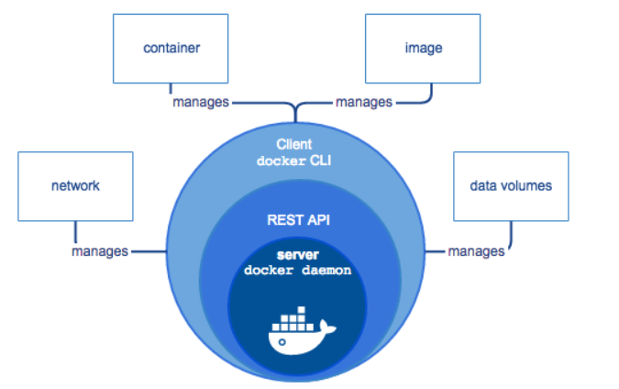
Building Blocks
Docker Engine: Docker Engine is a client-server application with following major components:
Docker Daemon or server
Docker client: A command line interface(CLI)
A REST API which the Docker daemon and client uses to communicate with.
Docker Image and Container:
An image is a read-only template with instructions for creating a Docker container while a container is a running instance of an image which can be created, started, stopped, moved, or deleted using the Docker API or CLI.

Slide 6
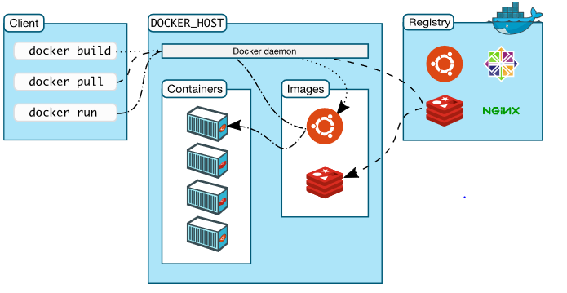
Building Blocks
Docker Hub (Registry)
Docker image default registry that allows us to store, pull container images.

Slide 7
Techniques behind Docker
LXC (Linux Containers): It is an operating-system-level virtualization method for running multiple isolated Linux systems (containers) on a single host sharing host’s Linux kernel.
The Linux kernel provides the cgroups functionality that allows limitation and prioritization of resources (CPU, memory, block I/O, network, etc.) without the need for starting any virtual machines, and also namespace isolation functionality that allows complete isolation of an application's view of the operating environment, including process trees, networking, user IDs and mounted file systems.

Slide 8
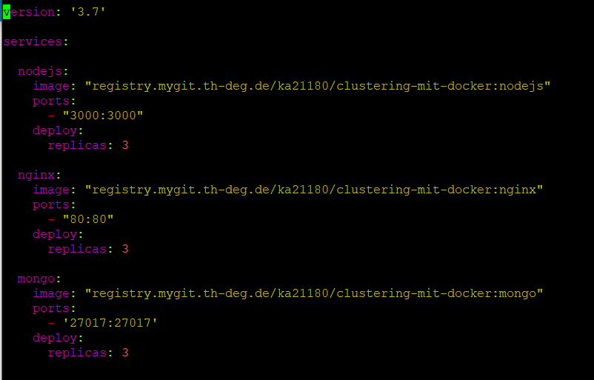
Docker Compose
What is Docker Compose?

Slide 9
Docker Compose
Docker Compose: Docker compose is a tool for defining and running multi-container docker applications using '.yml' file on a single docker host. With Compose, a YAML file is used to configure the application’s services.
Using Compose is basically a three-step process:
Define the app’s environment with a ‘Dockerfile’ so it can be reproduced anywhere.
Define the services that make up the app in ‘docker-compose.yml’ so they can be run together in an isolated environment.
Run ‘docker-compose up’ and Compose starts and runs the entire app.

Slide 10
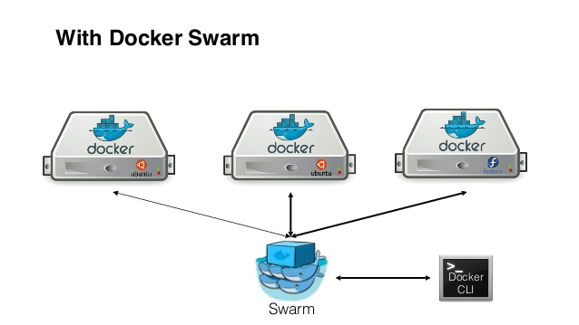
Docker Swarm
What is Docker Swarm?
Manager and worker node

Slide 11
Docker Swarm
Docker Swarm is a native clustering system for Docker. It manages multiple Docker hosts participating in the cluster behave as a single virtual host. It consists of multiple Docker hosts that run in swarm mode, acting as either manager or workers or performing both roles.
Docker Swarm offers the cluster management and orchestration features embedded in the Docker Engine needed to manage multiple containers when running a distributed application.

Slide 12
Docker Swarm
The Manager node initiates the swarm formation and is responsible for the orchestration and cluster management functions required to maintain the desired state of the swarm.
The worker nodes execute units of work called tasks assigned to them by the swarm manager.
Demonstration

Slide 13
Why Docker Swarm?
High Availability
Highly Scalable
Easy deployment and rollback
Load balancing

Slide 14
References
https://en.wikipedia.org/wiki/LXC
https://docs.docker.com/compose/
https://docs.docker.com/engine/swarm/stack-deploy/
https://itnext.io/chroot-cgroups-and-namespaces-an-overview-37124d995e3d

Slide 15
Thanks!

